Slide 1
Person of Interest Recognition – I/O
Face detection and face recognition techniques are used.
This is mainly targeting IoT sensors with mini server attached.
If the person of Interest can be recognized at local server before transferred to main server, it will fasten the speed and reduce the server traffic.
Hence, only final recognition result is output to the main server.

Slide 2
Person of Interest Recognition – Environment
In this context, few human faces will be selected as targeted faces in this project.
Targeted faces will be captured using same camera that will be used in the testing environment.
The testing location is in an exhibition hall which has a bright lighting. There is human flow and no restriction of entry. However, camera is installed at fixed spot.

Slide 3
Person of Interest Recognition – Complication
Multiple faces can be taken into an image frame at the same time.
Lighting can be different in between testing ground and training ground. Bright lighting (which is mainly yellow lighting that has significant R and G component) can reduce the contrast in between face and surrounding environment. Face area which is not exposed to the light may not be recognized.
Though targeted face is known, the application ground is an open space that allow free movement. Hence, accuracy varies between individual visitor.
For the targeted face, not all facial expression/hair style can be captured. Spectacle effect can also be extra factor to the recognition accuracy.

Slide 4
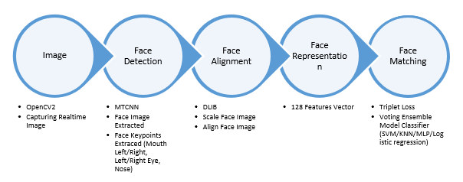
Person of Interest Recognition – System Capability
1. Image capturing
2. Training face recognition
3. Testing/Use the model in real time face recognition

Slide 5
Person of Interest Recognition – Image Preprocessing
Using opencv2 in image capturing from video stream.
Haar Wavelet face cascade method (standard function used in opencv2) is used to capture the human face pixels.
Use MTCNN (in courtesy of MIT) to refine the face area captured using Haar Wavelet.
Disallow image capturing if MTCNN cannot capture eye/nose/mouth location.

Slide 6
Person of Interest Recognition – Image Preprocessing
Using opencv2 in image capturing from video stream.
Haar Wavelet face cascade method (standard function used in opencv2) is used to capture the human face pixels.
Use MTCNN (in courtesy of MIT) to refine the face area captured using Haar Wavelet.
Disallow image capturing if MTCNN cannot capture eye/nose/mouth location.

Slide 7
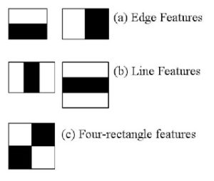
Haar Face Cascade
Haar Cascade has 4 stages:
Haar Feature Selection
Creating Integral Images
Adaboost Training
Cascading Classifiers
In feature selection, it actually gets Haar features such as edge features and line features. Although not exactly a resultant of Haar Wavelet, Haar features can be calculated thru integral images method that is implemented in the opencv.
Notes:
[1] Rapid Object Detection using a Boosted Cascade of Simple Features , 2001.

Slide 8
Haar Face Cascade
For each features, we will try to find out what is the best threshold that can predict whether the trained images are human face or not.
However, not all features obtained thru integral images are useful. The model applied on the features are considered to be weak classfier as each of them only holds information at certain spatial region of the whole image.
Adaboost classfiers are actually an ensemble classfier of the weak classfier that applied on each Haar feature. Boosting allows stronger feature classifer to be ensembled as a weighted averaged strong classfier.
Finally, the Adaboost classfiers are cascaded in stages. As a result, image area that fits the face features the most are highlighted.

Slide 9
MTCNN – Face Alignment
MTCNN or Multi-Task Cascaded Convolutional Neural Network is used for face landmark detection and face boundary detection.
MTCNN has 3 stages of convolutional neural networks namely, P-Net (Proposal), R-Net (Refine) and O-Net (Output)
Best bounding coordinate and 5 face landmark coordinates are selected.
Notes:
[2] Zhang, K., Zhang, Z., Li, Z., and Qiao, Y. (2016). Joint face detection and alignment using multitask cascaded convolutional networks. IEEE Signal Processing Letters, 23(10):1499–1503.
Explaination: https://towardsdatascience.com/how-does-a-face-detection-program-work-using-neural-networks-17896df8e6ff

Slide 10
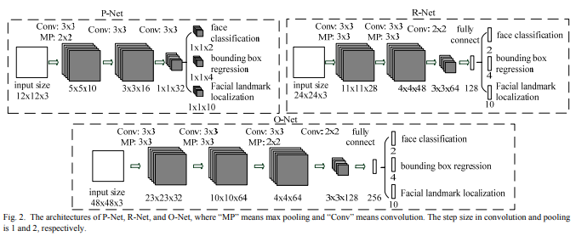
MTCNN

Slide 11
Face Encoding
Face encoding is done through face_recognition python library developed by Ageitgey. This library is mainly based on open source Dlib.
Face_recognition library return result in 128-bit code and hence suitable for face encoding.
Face_recognition has several steps to refine and encode the face image:
1. face detection using HoG (further refine bounding area from MTCNN in this project)
2. dlib face landmark detection and face projection
3. neural network trained using triplet loss for error computation
Notes:
[3] Theory: https://medium.com/@ageitgey/machine-learning-is-fun-part-4-modern-face-recognition-with-deep-learning-c3cffc121d78
Github: https://github.com/ageitgey/face_recognition

Slide 12
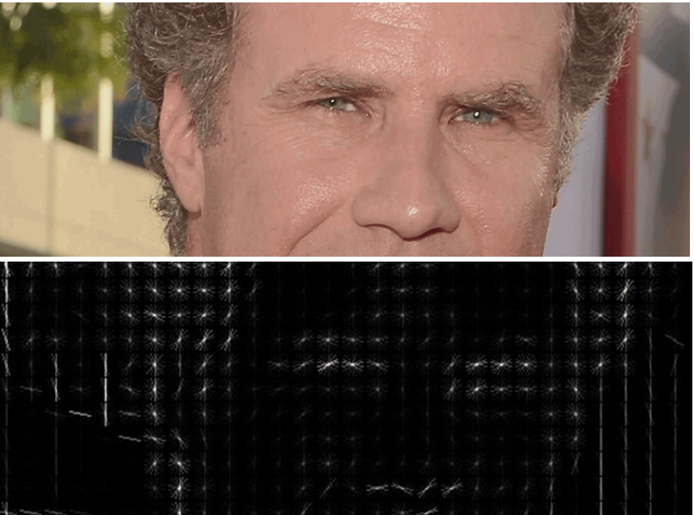
HoG Representation

Slide 13
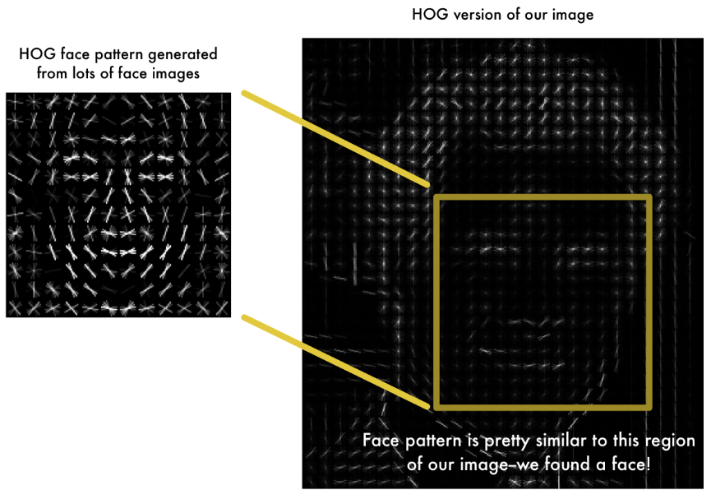
HoG based Face Recognition

Slide 14
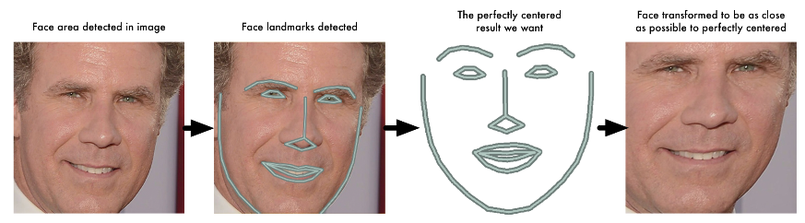
Face_recognition face re-projection

Slide 15
Face encoding
With DLIB face re-projection, Ageitgey is able to train a neural network with much less sample size. It defines the input to the network to have correct face alignment.
Ageitgey’s network is computing triplet loss for error correction.
Triplet loss computation means three images are input to the network at the same time. Though there are three images, all the image are going thru shared layers. (This means all three sub-networks are exactly the same layers with same weight)

Slide 16
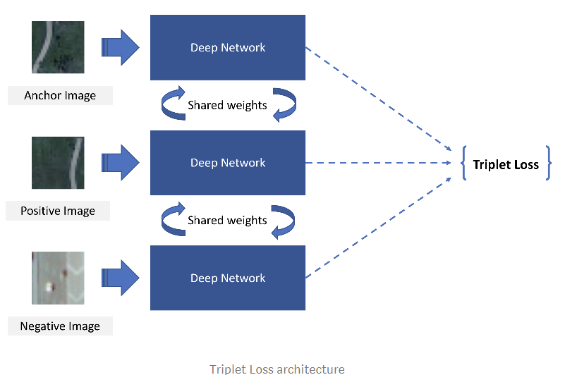

Slide 17
Face encoding
The 3 images are a training face image of a known person, another picture of the same known person and a picture of a totally different person.
With this combination, weight in between similar faces are closer while the weight in between different face are further.
This applies to all 128-bit that represent 128 measurements made at the face features.
With pre-trained weights from face_recognition python library, the face_recognition can be used with up to 98% accuracy at application time.

Slide 18
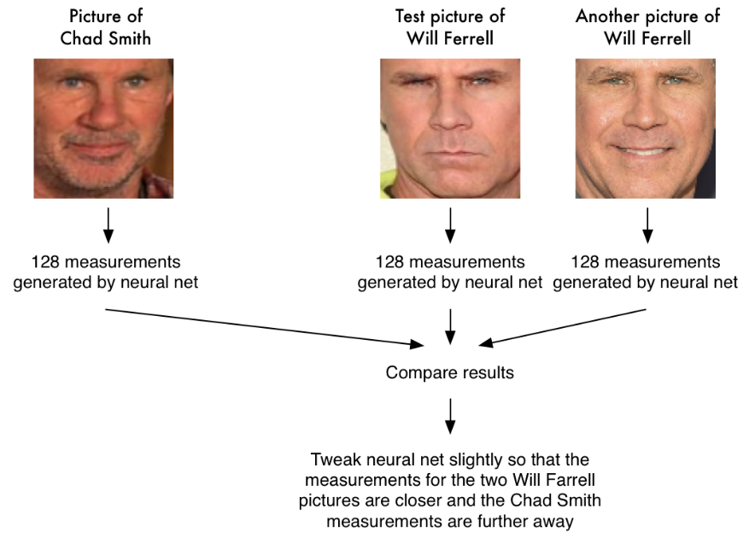

Slide 19
Face Recognition Model
3 Targeted faces and >100 non-targeted faces are pre-processed using MTCNN (Background removal), and augmented.
As a result, ~100000 images are input into the system.
With the 128-byte code, it is now a smaller dataset which enables Classifier models to be trained for the final image recognition.
In this project, KNN, SVM, Logistic Regression and MLP are used to classify the 128-bit into certain person of Interest.
The output of each model is ensembled using voting system.
The whole system is able to make recognition in 0.2-0.6s depend on the CPU/GPU ran which is suitable to the mini server environment.
Notes:
[3] FaceNet: A Unified Embedding for Face Recognition and Clustering
Florian Schroff, Dmitry Kalenichenko, James Philbin
(Submitted on 12 Mar 2015 (v1), last revised 17 Jun 2015 (this version, v3))

Slide 20
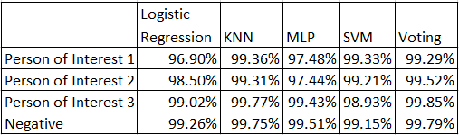
Accuracy of Classifier

Slide 21
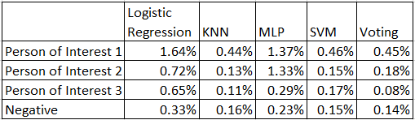
False Positive at Classifier

